Slide 1
Solution
Design for Governance

Slide 2



Tenant Root Group
Apparel
Sporting Goods
Tailwind
Product Development
Marketing
Sales
Product Development
Marketing
Sales

Slide 3
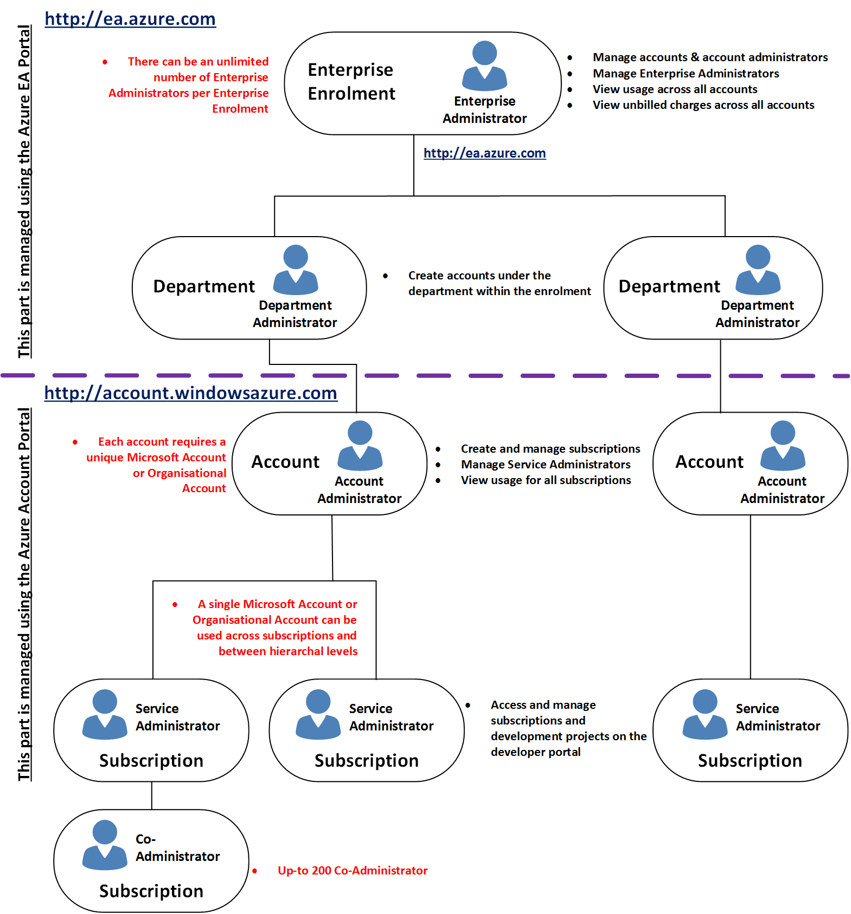




Slide 4
New Development Project
Tracking Cost:
Tags
Azure Policy – Force enforce tags
Subscription to report billing
One RG and place all new development project resources in this resource group
Compliance:
Policy – Ensure only certain size of VMs can be created
Policy - Nomenclature

